Slide 1
SOFT COMPUTING
The idea of soft computing was initiated in 1981 when Lotfi A. Zadeh published his first paper on soft data analysis “What is Soft Computing”, Soft Computing. Springer-Verlag Germany/USA 1997.].
DDE

Slide 2
Slides for Fuzzy Sets, Ch. 2 of Neuro-Fuzzy and Soft Computing
J.-S. Roger Jang (張智星)
CS Dept., Tsing Hua Univ., Taiwan
http://www.cs.nthu.edu.tw/~jang
jang@cs.nthu.edu.tw
Modified by Dan Simon
Fall 2010
Notes:
...
In this talk, we are going to apply two neural network controller design techniques to fuzzy controllers, and construct the so-called on-line adaptive neuro-fuzzy controllers for nonlinear control systems. We are going to use MATLAB, SIMULINK and Handle Graphics to demonstrate the concept. So you can also get a preview of some of the features of the Fuzzy Logic Toolbox, or FLT, version 2.

Slide 4

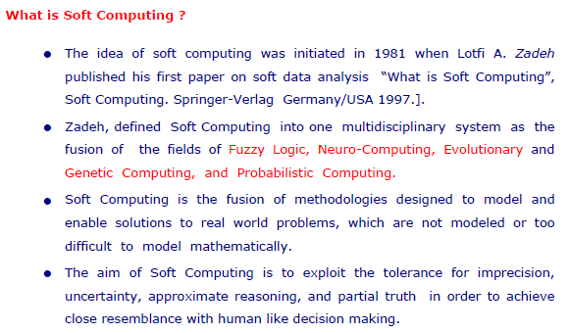

Slide 5
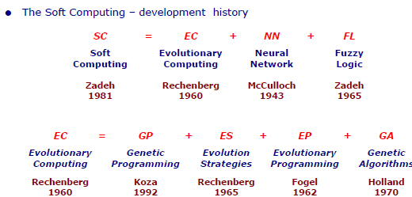

Slide 6
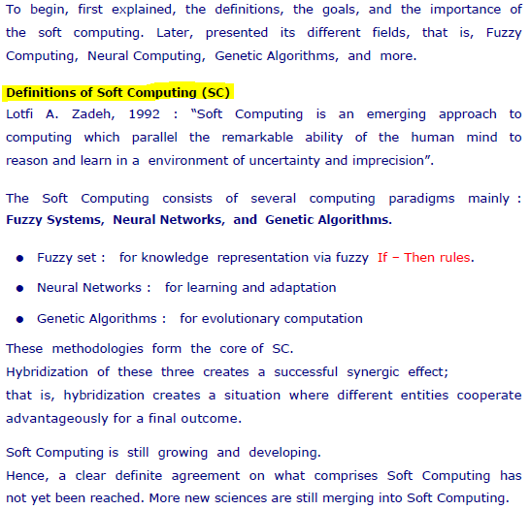
Introduction:

Slide 7
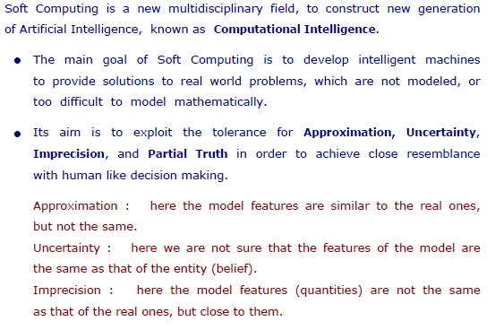
Goals of Soft Computing:

Slide 8
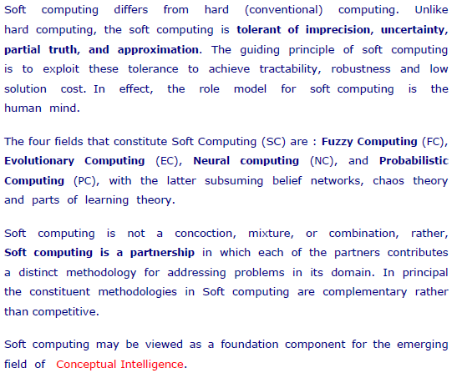
Importance of Soft Computing:

Slide 9
Soft Computing vs Hard Computing
What is Computing?
The process of accomplishing a particular task with the help of a computer or a computing device is known as computing. It should provide precise and accurate solutions, also it makes easy to find the mathematical solution of the problems.
1) Soft Computing
Soft computing and hard computing are computing methods where hard computing is the conventional methodology relies on the principles of accuracy, certainty, and inflexibility. Conversely, soft computing is a modern approach premised on the idea of the approximation, uncertainty, and flexibility
Soft computing deals with approximate models and gives solutions to complex real-world problems. Soft computing is an approach that gives an impression on the human mind to reason and learns in an environment of uncertainty and impression.
Soft computing deals with imprecision, uncertainty, partial truth and approximation to achieve close resemblance with human decisions.
The cost of the solution also very low in this kind of computing, it forms the basis of a considerable amount of machine learning techniques.
Components of soft computing are as follows:
Machine learning, neural network, fuzzy logic, perception, genetic algorithms, etc.

Slide 10
2) Hard Computing
Hard computing is suitable for mathematical problems, although it might be used to solve real-world problems, it consumes a large amount of computation time and cost. So, in this case, soft computing is a better alternative as compared to hard computing.
Applications of hard computing are mobile robot coordination and forecasting combinational problems.
If we want to solve the deterministic problems, we can use a hard computing approach. As the problem grows in size and complexity, the design search space also increases.

Slide 11
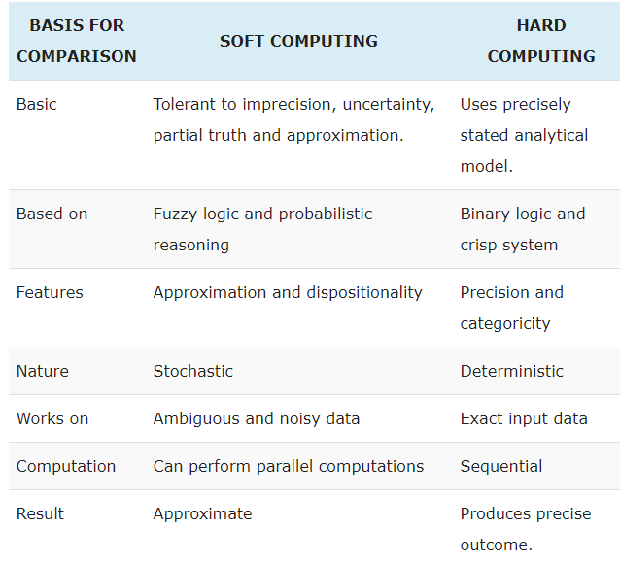

Slide 12
Conventional Computing vs. Intelligent Computing
Artificial intelligence is the intelligence exhibited by machines or software. It is also an academic field of study. Major AI researchers and textbooks define the field as "the study and design of intelligent agents", where an intelligent agent is a system that perceives its environment and takes actions that maximize its chances of success.
Computational Intelligence:
Computational intelligence is a set of nature-inspired computational methodologies and approaches to address complex real-world problems to which traditional approaches, first principles modeling or explicit statistical modeling, are ineffective or infeasible. Many such real-life problems are not considered to be well-posed problems mathematically, but nature provides many counterexamples of biological systems exhibiting the required function, practically.
Differences Classifiers make use of pattern recognition for condition matching. In many cases this does not imply absolute, but rather the closest match. Techniques to achieve this divide roughly into two schools of thought: Conventional AI and Computational intelligence (CI).

Slide 13
Conventional Computing vs. Intelligent Computing
Conventional AI research focuses on attempts to mimic human intelligence through symbol manipulation and symbolically structured knowledge bases. This approach limits the situations to which conventional AI can be applied. Lotfi Zadeh stated that "we are also in possession of computational tools which are far more effective in the conception and design of intelligent systems than the predicate-logic-based methods which form the core of traditional AI." These techniques, which include fuzzy logic, have become known as soft computing. These often biologically inspired methods stand in contrast to conventional AI and compensate for the shortcomings of symbolicism. These two methodologies have also been labeled as neats vs. scruffies, with neats emphasizing the use of logic and formal representation of knowledge while scruffies take an application-oriented heuristic bottom-up approach.
1. Intelligent computing does not guarantee a solution to a given problem. Conventional computing guarantees a solution to a given problem.
2. In intelligent computing, results may not be reliable and consistent. In conventional computing, results are consistent and reliable.
3. In intelligent computing, a programmer does not tell the system how to solve the given problem. In conventional computing, programmer tells the system exactly how to solve the problem.
4. Intelligent computing can solve a range of problems in a given domain. Conventional computing can solve only one problem at a time in a given domain.

Slide 14
• The notion of artificial intelligence in computing started with attempts at
replicating the human ways of reasoning in computing.
To classify a device as “intelligent,” it should necessarily satisfy the following
requirements:-
Learning/adapting: It should be able to learn from the environment it is working in.
2. Decision making/classification: It should be able to make decisions relevant to the environment it is deployed in, on new and unknown inputs.

Slide 15
Necessity of Intelligent Computing
What is computational intelligence all about?
• Many engineering and scientific problems may be solved by using
numerical algorithms; theory is known, equations formulated, either
analytical or numerical solutions are required.
Such problems require high-performance computing, but no intelligence:
just press the key and wait for an answer.
• Other problems may be easily formulated, but all algorithms solving them
may be NP hard, requiring almost infinite amount of computations to
solve complex cases.
• Yet other problems have no algorithms at all!
• Problems, for which effective algorithms cannot be formulated require
intelligence to solve them.

Slide 16
Some non-algorithmizable problems
(these require CI)
• Understanding meaning of sentences (queries), all problems related to natural language analysis.
• Perception: recognition of signals, phoneme recognition, olfactory(smell) signals – first step in robotics.
• Visual perception: face recognition, object recognition and many computer vision problems.
• Hand-written characters recognition for PDAs or security.
• Control and planning problems in robotics and control of non-linear complex systems with many degrees of freedom.
• Medical diagnostics, interpretation of medical images and biomedical signals (EEG, ECG ...), therapy planning.
• Playing complex games, like strategic war games.
• Solving untypical problems, or problems requiring creativity

Slide 17
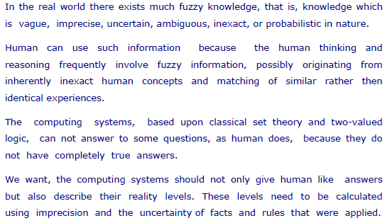
Fuzzy Computing:

Slide 18
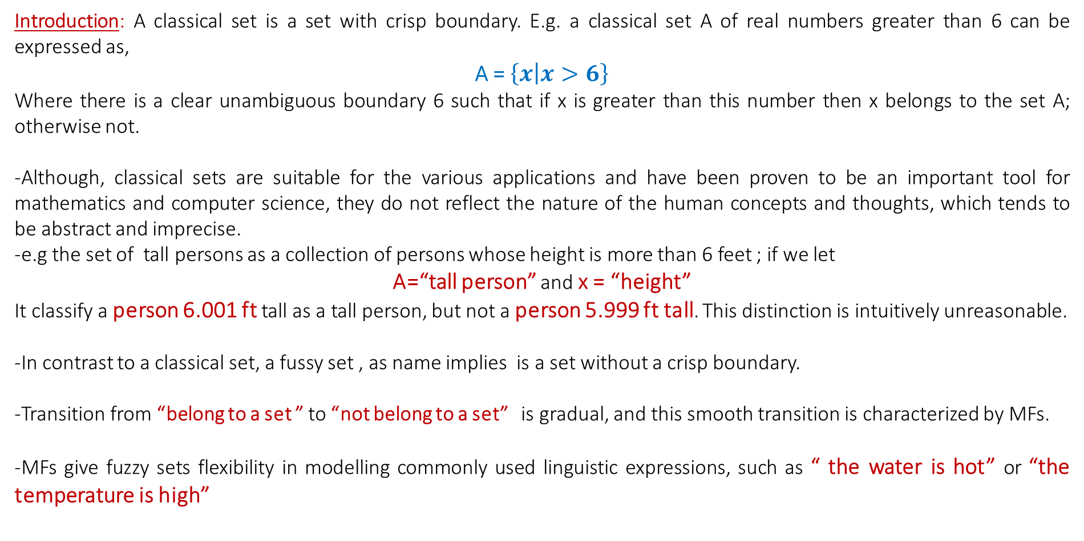
Fuzzy sets
Introduction: A classical set is a set with crisp boundary. E.g. a classical set A of real numbers greater than 6 can be expressed as,
A = $\left\{x | x>6\right\}$
Where there is a clear unambiguous boundary 6 such that if x is greater than this number then x belongs to the set A; otherwise not.
-Although, classical sets are suitable for the various applications and have been proven to be an important tool for mathematics and computer science, they do not reflect the nature of the human concepts and thoughts, which tends to be abstract and imprecise.
-e.g the set of tall persons as a collection of persons whose height is more than 6 feet ; if we let
A=“tall person” and x = “height”
It classify a person 6.001 ft tall as a tall person, but not a person 5.999 ft tall. This distinction is intuitively unreasonable.
-In contrast to a classical set, a fussy set , as name implies is a set without a crisp boundary.
-Transition from “belong to a set ” to “not belong to a set” is gradual, and this smooth transition is characterized by MFs.
-MFs give fuzzy sets flexibility in modelling commonly used linguistic expressions, such as “ the water is hot” or “the temperature is high”

Slide 19
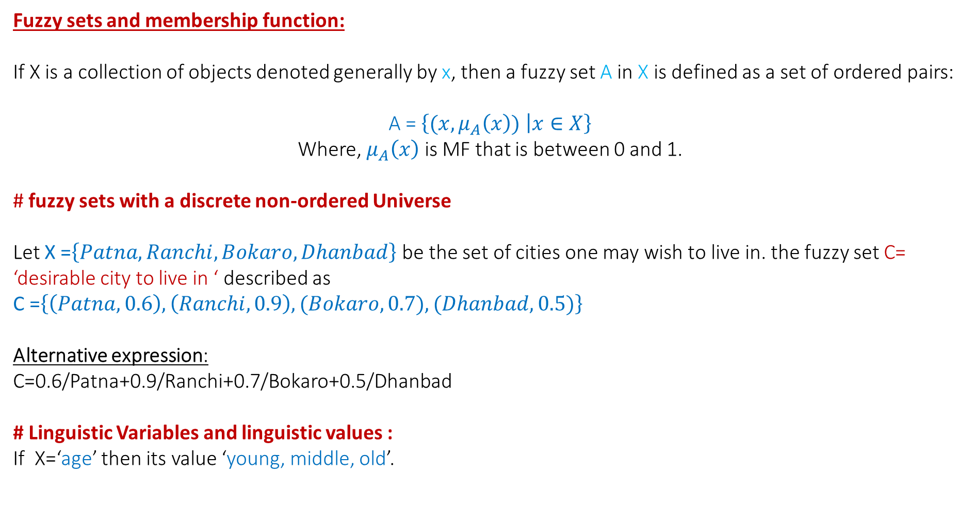
Fuzzy sets
Fuzzy sets and membership function:
If X is a collection of objects denoted generally by x, then a fuzzy set A in X is defined as a set of ordered pairs:
A = $\left\{(x,μ_{A}\left(x\right)) | x∈X\right\}$
Where, $μ_{A}\left(x\right)$ is MF that is between 0 and 1.
# fuzzy sets with a discrete non-ordered Universe
Let X =$\left\{Patna, Ranchi, Bokaro, Dhanbad\right\}$ be the set of cities one may wish to live in. the fuzzy set C= ‘desirable city to live in ‘ described as
C =$\left\{\left(Patna,0.6\right), \left(Ranchi,0.9\right), (Bokaro,0.7), (Dhanbad,0.5)\right\}$
Alternative expression:
C=0.6/Patna+0.9/Ranchi+0.7/Bokaro+0.5/Dhanbad
# Linguistic Variables and linguistic values :
If X=‘age’ then its value ‘young, middle, old’.

Slide 20
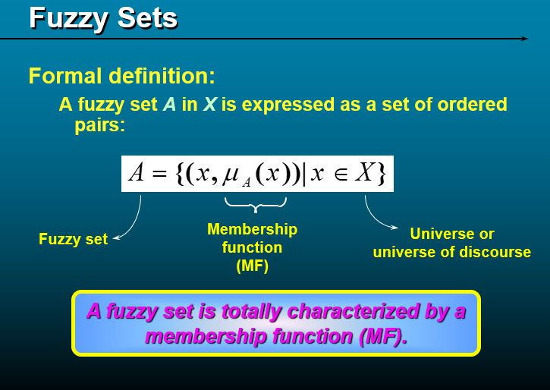

Slide 21
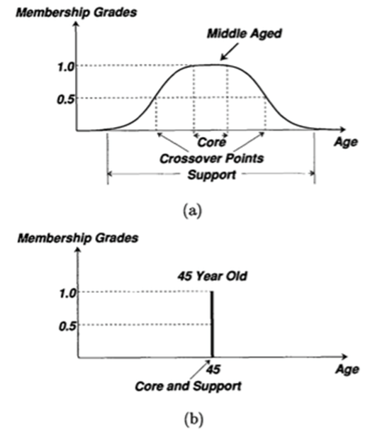
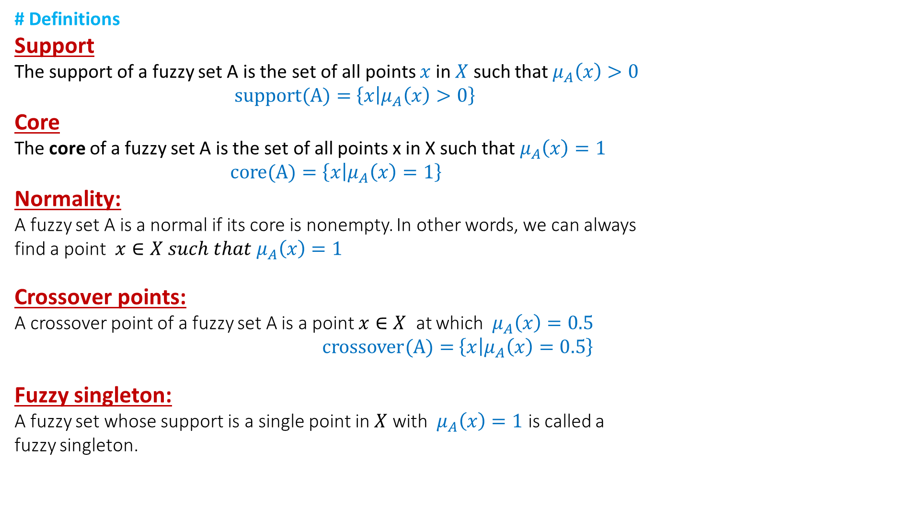
Fuzzy sets
# Definitions
Support
The support of a fuzzy set A is the set of all points $x$ in $X$ such that $μ_{A}\left(x\right)>0$
$support(A)=$ $\left\{x | μ_{A}\left(x\right)>0\right\}$
Core
The core of a fuzzy set A is the set of all points x in X such that $μ_{A}\left(x\right)=1$
$core(A)=\left\{x | μ_{A}\left(x\right)=1\right\}$
Normality:
A fuzzy set A is a normal if its core is nonempty. In other words, we can always
find a point $x∈X such that{ μ}_{A}\left(x\right)=1$
Crossover points:
A crossover point of a fuzzy set A is a point $x∈X$ at which ${ μ}_{A}\left(x\right)=0.5$
$crossover(A)=$ $\left\{x | μ_{A}\left(x\right)=0.5\right\}$
Fuzzy singleton:
A fuzzy set whose support is a single point in $X$ with ${ μ}_{A}\left(x\right)=1$ is called a
fuzzy singleton.

Slide 22
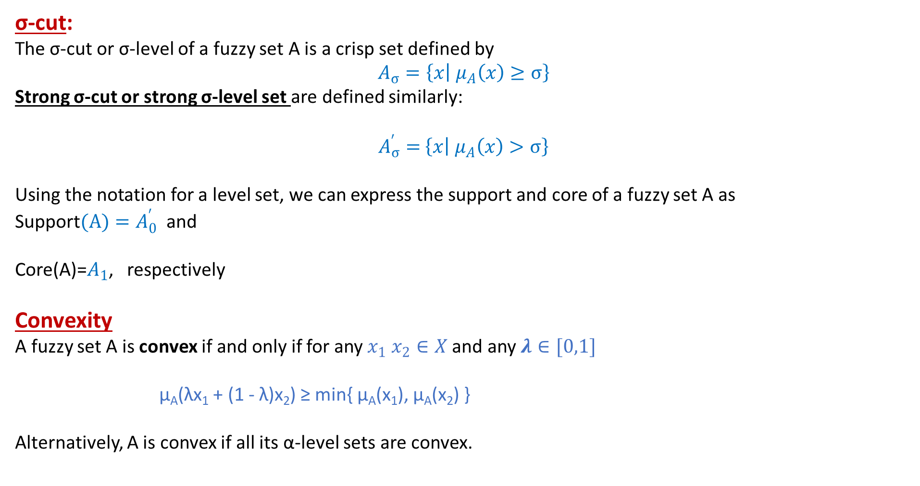
Fuzzy Sets
σ-cut:
The σ-cut or σ-level of a fuzzy set A is a crisp set defined by
$$A_{σ}=\left\{x | { μ}_{A}\left(x\right)≥σ\right\}$$
Strong σ-cut or strong σ-level set are defined similarly:
$A_{σ}^{′}=$ $\left\{x | { μ}_{A}\left(x\right)>σ\right\}$
Using the notation for a level set, we can express the support and core of a fuzzy set A as
Support$(A)=A_{0}^{′}$ and
Core(A)=$A_{1}$, respectively
Convexity
A fuzzy set A is convex if and only if for any $x_{1} x_{2}∈X$and any $λ∈[0,1]$
μ_{A}(λx₁ + (1 - λ)x₂) ≥ min{ μ_{A}(x₁), μ_{A}(x₂) }
Alternatively, A is convex if all its α-level sets are convex.

Slide 23
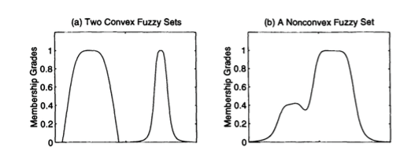
Fuzzy sets
crisp set C in R^{n} is convex if and only if for any two points x₁ ∈ C and x₂ ∈ C, their convex combination λx₁ + ( 1 - λ)x₂ is still in C, where 0 ≤ λ ≤ 1. Hence the convexity of a (crisp) level set A_{α} implies that A_{α} is composed of a single line segment only.
Note that the definition of convexity of a fuzzy set is not as strict as the common definition of convexity of a function. For comparison, the definition of convexity of a function f(x) is
f( λx₁ + ( 1 - λ )x₂ ) ≥ λf(x₁) + ( 1 - λ )f(x₂)
which has a tighter condition.
Figure below illustrates the concept of convexity of fuzzy sets; Figure (a) shows two convex fuzzy sets, the left fuzzy set satisfies both Equations, while the right one satisfies Equation 1 only. Figure (b) is a nonconvex fuzzy set.

Slide 24
Fuzzy numbers
A fuzzy number A is a fuzzy set in the real line (R) that satisfies the conditions for normality and convexity.
Most (non-composite) fuzzy sets used in the literature satisfy the conditions for normality and convexity, so fuzzy numbers are the most basic type of fuzzy sets.
Bandwidths of normal and convex fuzzy sets
For a normal and convex fuzzy set, the bandwidths or width is defined as the distance between the two unique crossover points:
width(A) = | x₂ - x₁ |
where μ_{A}(x₁) = μ_{A}(x₂) = 0.5.
Symmetry
A fuzzy set A is symmetric if its MFs is symmetric around a certain point x = c, namely,
μ_{A}( c + x ) = μ_{A}( c - x ) for all x ∈ X

Slide 25
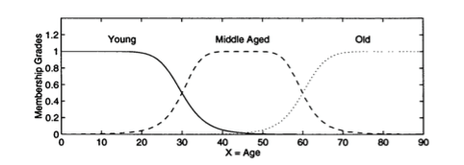
Open left, open right, closed
A fuzzy set A is
open left if
lim_{x→-∞}μ_{A}(x) = 1 and lim_{x→+∞}μ_{A}(x) = 0;
open right if
lim_{x→-∞}μ_{A}(x) = 0 and lim_{x→+∞}μ_{A}(x) = 1;
closed if
lim_{x→-∞}μ_{A}(x) = lim_{x→+∞}μ_{A}(x) = 0;
For example, the fuzzy set "young" is open left; "old" is open right; and "middle aged" is closed.

Slide 26
Set theory operations
Union, intersection and complement
The main features of operation on fuzzy set are that unlike conventional sets, operations on fuzzy sets are usually described with reference to membership function. When I say operation, I do not do with the member itself, but I manipulate. When I say operation, I manipulate the membership of the members in a set; members are not manipulated, rather the membership function of the member is manipulated. This is very important; that is, x and μ( x). In classical set what is manipulated is x.
If I say, x is 1 In classical set when I say x is 1 then, I would say 1 minus x is 0. In this, the manipulation concerns with the member; whereas any kind of manipulation in fuzzy set does not involve with x; rather it involves μx.
Containment or subset:
Three common operations: intersection which we say is the minimum function, union, which we say is the maximum function and then fuzzy complementation

Slide 27
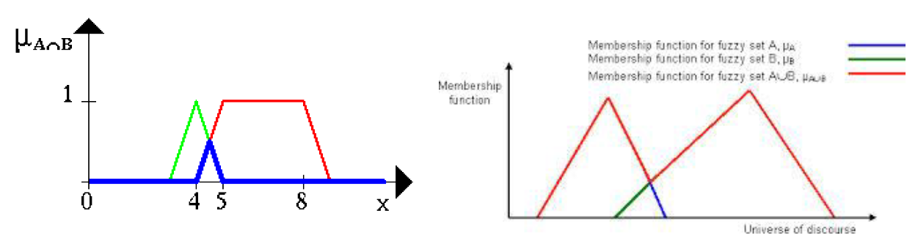
Standard fuzzy operations:
Intersection(Conjunction)or T-norm:
We can easily see that, the membership of A (green) intersection B(red) in fig. is all the members that belongs to, that is common between A and B. Their membership will follow these (blue) curves. There are two things we are doing. We have 2 sets. One is set A and the other is set B. Classically, what we see is the common members between A and B. We are not only seeing the common members, here we are also seeing, what is their membership function.
Fig. Fuzzy set operations intersection & union
The membership function is computed minimum; that is, μA intersection B is minimum of μA x and μ B x. That is the membership function. When there is a common member between A and B, the membership function wherever is minimum that is retained and the other one is thrown away. The member is retained; what is changing is the membership function

Slide 28
Union(Disjunction) or T-co-norm or S-norm:
That is the meaning of these two curves that we have and then we are trying to find out what the fuzzy union is. I have to find out In this the members are both belonging to A and B. But their membership is maximum of both. if I have common members. I have set A and I have set B; A union B is my union set. If x belongs to A and x belongs to B, then x also belongs to A union B. But in fuzzy set, here this is μ A x and here it is μ x and in this case, this is maximum of μA x and μB x; the membership function. That is the way it is assigned.
This candidate, when it comes to A union B take these two values of membership, find the maximum which is 0.1 and assign here, which is 0.1. This is, μ union B is 0.1. This is the meaning. This is a very important operation that we do. When we have two different fuzzy sets, the operations are classical. The manipulation is among the membership functions; otherwise, the notion of the classical fuzzy operation also remains intact, except that the associated fuzzy membership gets changed.
Complement(Negation):
now it is fuzzy complementation. What is complement? This one, this particular triangular function is my set R(red); fuzzy set R. The complement is like this; just inverse (blue). What is 1 minus μA x; meaning 1 minus μA x.

Slide 29
Fig. Complement of fuzzy set
What is seen that the members remain intact in the set A, whereas the associated membership functions got changed.
The other operations that we know for classical sets like De Morgan’s law, the difference also can be used for the sets like De Morgan’s law.
Properties/ identities of fuzzy sets:
They are commutative. A union B is B union A; A intersection B is B intersection A. It is like classical sets; fuzzy sets equally hold.
Associativity; A union B union C is A union B union C. Similarly, A union bracket B union C is A intersection B intersection C is A intersection B combined with intersection C.

Slide 30
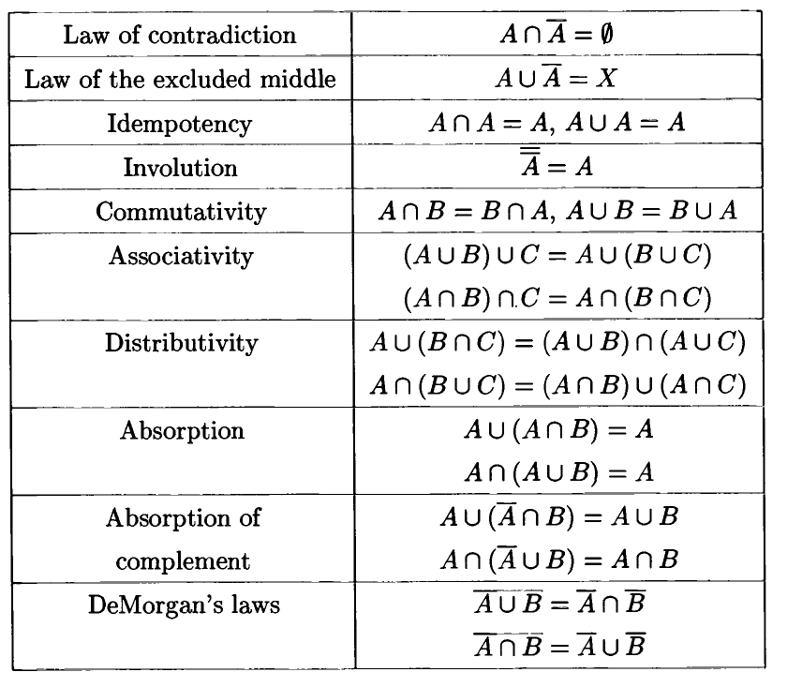

Slide 31
Hedges :
Another important feature of fuzzy systems is the ability to define "hedges," or modifier of fuzzy values. These operations are provided in an effort to maintain close ties to natural language, and to allow for the generation of fuzzy statements through mathematical calculations. As such, the initial definition of hedges and operations upon them will be quite a subjective process and may vary from one project to another. Nonetheless, the system ultimately derived operates with the same formality as classic logic. The simplest example is in which one transforms the statement "Jane is old" to "Jane is very old."
The hedge "very" is usually defined as follows:
μ"very"A(x) = μA(x)^2
Thus, if mOLD(Jane) = 0.8, then mVERYOLD(Jane) = 0.64.
Other common hedges are "more or less" [typically SQRT(μA(x))], "somewhat," "rather," "sort of," and so on. Again, their definition is entirely subjective, but their operation is consistent: they serve to transform membership/truth values in a systematic manner according to standard mathematical functions.

Slide 32
Cartesian Product & Co-product:
Let A & B be fuzzy sets in X & Y respectively, then Cartesian product of A & B is a fuzzy set in the product space XxY with the membership function
Similarly, Cartesian co-product A+B is a fuzzy set
Both Product & Co-product are characterized by 2- dimensional MFs.

Slide 33
MF FORMULATION AND PARAMETERIZATION
As we know fuzzy set is completely characterized by its MFs.
Since most fuzzy sets in use have a universe of discourse X consisting of real line R, it would be impractical to list all the pairs defining a membership function.
A more convenient and concise way to define an MF is to express it as a mathematical formula.
The classes of parameterized functions commonly used to define MFs of one and two dimensions.
MFs of higher dimensions can be defined similarly. Moreover, we give the derivatives of some of the MFs with respective to their inputs and parameters.
These derivatives are important for fine-tuning a fuzzy inference system to achieve a desired input/output mapping.
# MFs of One Dimension
First, we define several classes of parameterized MFs
of one-dimension-that is, MFs with a single inputs.

Slide 34
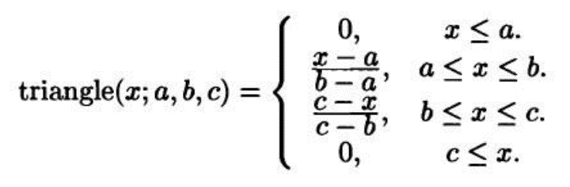
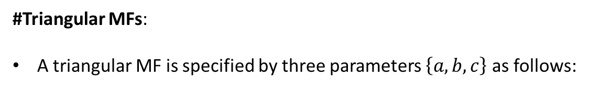
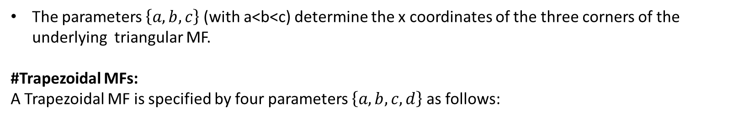
#Triangular MFs:
A triangular MF is specified by three parameters $\left\{a,b,c\right\}$ as follows:
By using min and max, we have an alternative expression for the preceding equation:
$$triangle\left(x;a, b,c\right)=max\left(min\left(\frac{x−a}{b−a},\frac{c−x}{c−b}\right),0\right)$$
The parameters $\left\{a,b,c\right\}$ (with a<b<c) determine the x coordinates of the three corners of the underlying triangular MF.
#Trapezoidal MFs:
A Trapezoidal MF is specified by four parameters $\left\{a,b,c,d\right\}$ as follows:

Slide 35
An alternative concise expression using min and max is
Triangular MF:
Trapezoidal MF:
Due to their simple formulas and computational efficiency both triangular MF and trapezoidal MF have been used extensively, especially in real time implementations. However since MF are composed of straight line segments, they are not smooth at the corner points specified by parameters. Other smooth and non-linear functions are defined
Gaussian MF:
Generalized bell MF:

Slide 36
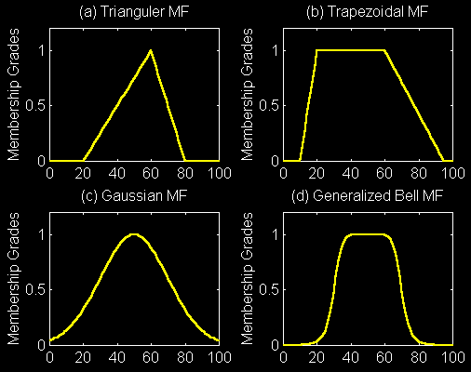
(a) Triangulation (x;20,60,80) (b)trapezoidal(x;10,20,60,95) (c ) gaussian(x;50,20) (d)bell(x;20,4,50)

Slide 37
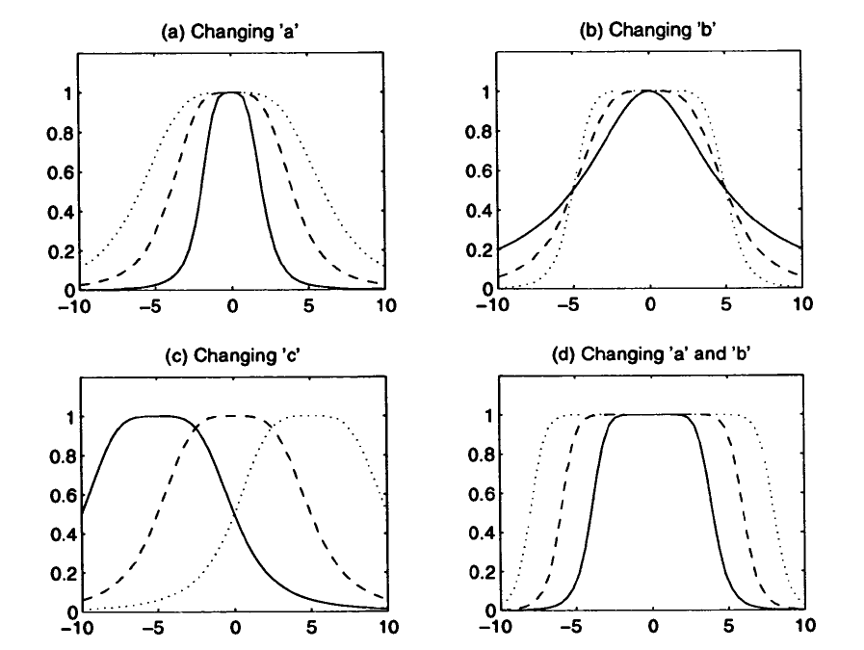
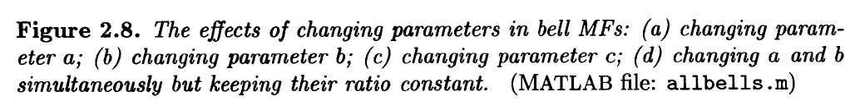

Slide 38
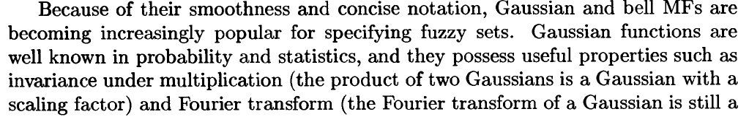
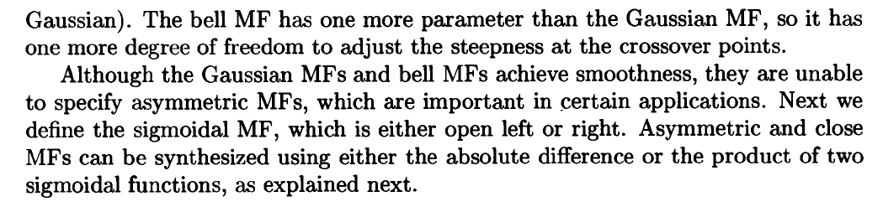
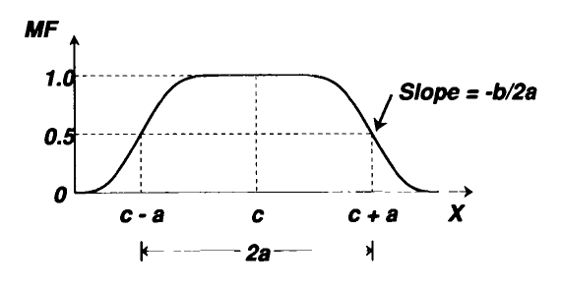
Figure: Physical meaning of parameters in generalized bell MF

Slide 39
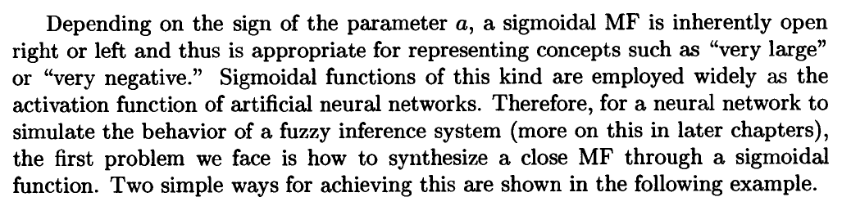
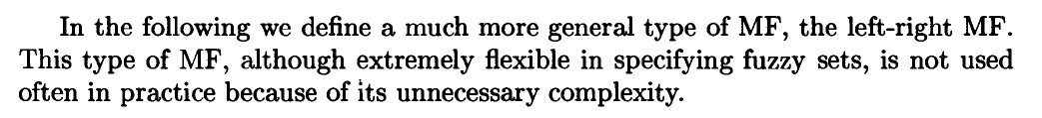
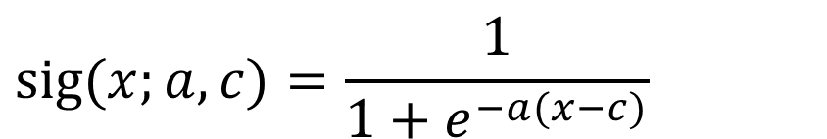
$$\text{sig}(x;a,c)=\frac{1}{1+e^{−a(x−c)}}$$
Sigmoidal MF:
Where a control the slope at the cross over point x=c, and right/left
Example: Close and asymmetric MFs based on sigmoidal functions

Slide 40
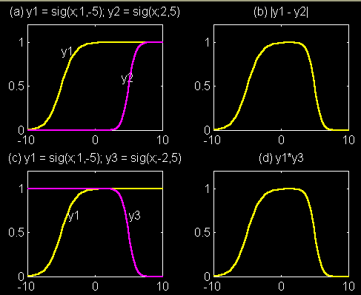
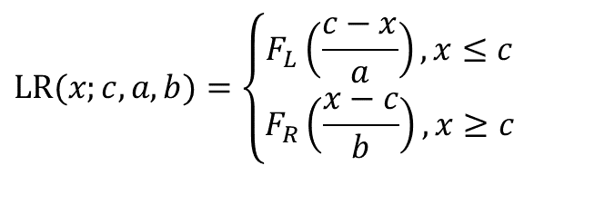
Abs. difference of two sig. MF
(open right MFs)
Product
of two sig. MFs
Definition: Left-right (L-R) MF
$$\text{LR}(x;c,a,b)=\left\{\begin{matrix}F_{L}\left(\frac{c−x}{a}\right),x≤c \\ F_{R}\left(\frac{x−c}{b}\right),x≥c\end{matrix}\right.$$

Slide 41
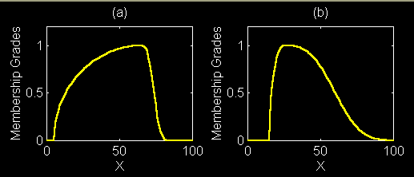
Example:
c=25
a=10
b=40
c=65
a=60
b=10

Slide 42
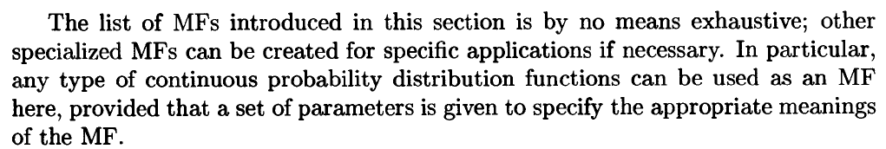
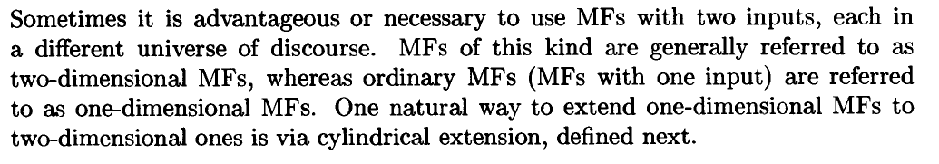
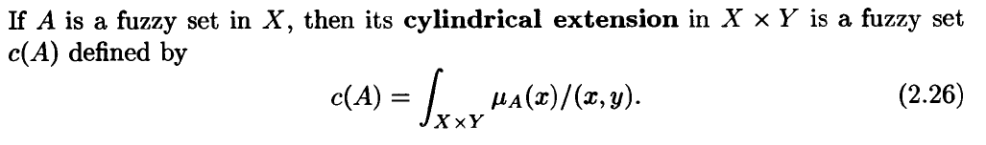
#MFs of two dimensions
Definition: Cylindrical extensions of one-dimensional fuzzy sets

Slide 43
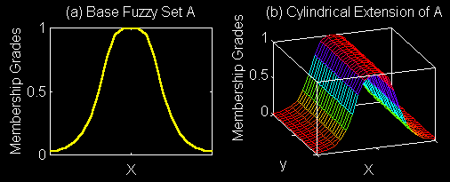
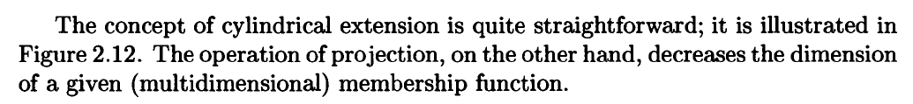
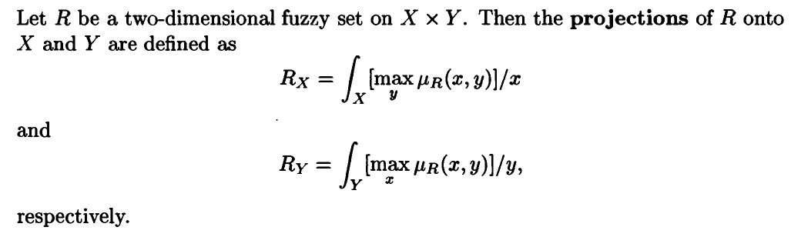
Base set A
Cylindrical Ext. of A
Definition: Projection of Fuzzy sets:

Slide 44
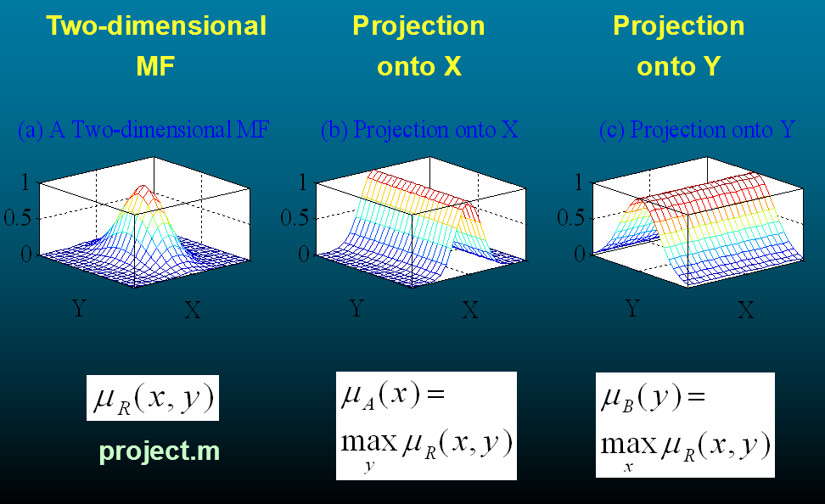
2D MF Projection

Slide 45
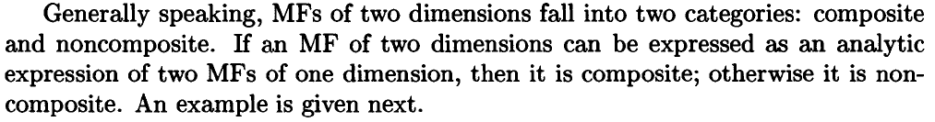
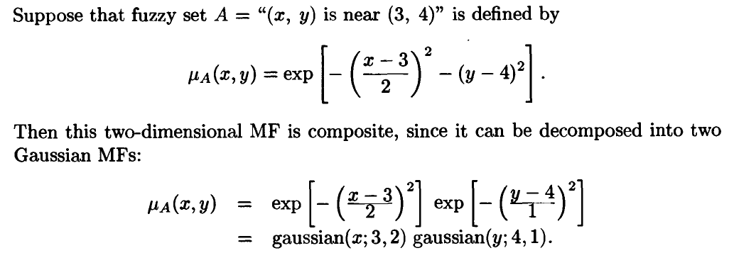
#Composite and non-composite MFs

Slide 46
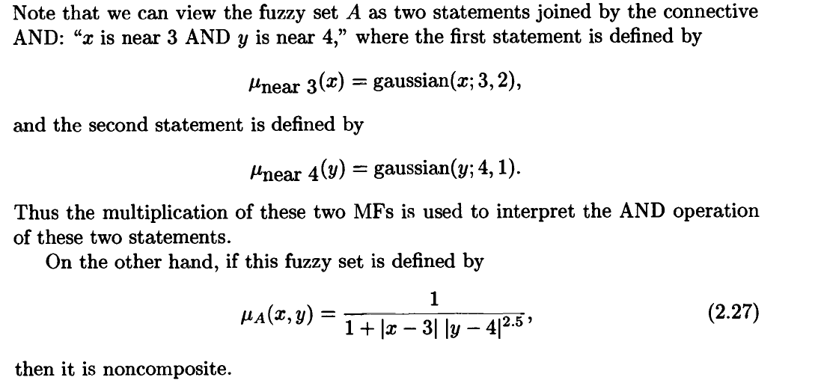

Slide 47
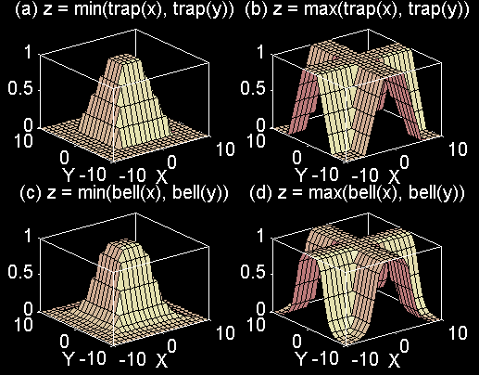
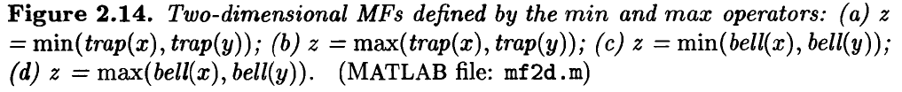
#Composite 2D MFs based on min and max operators

Slide 48
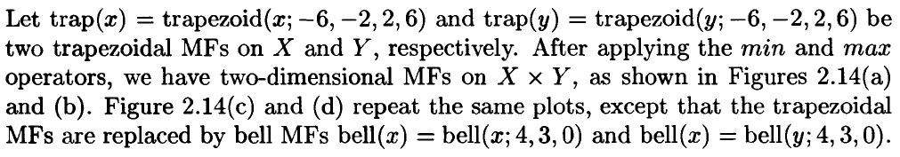
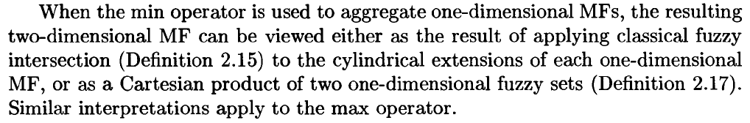
Example: composite two-dimensional MFs based on min and max operators

Slide 49
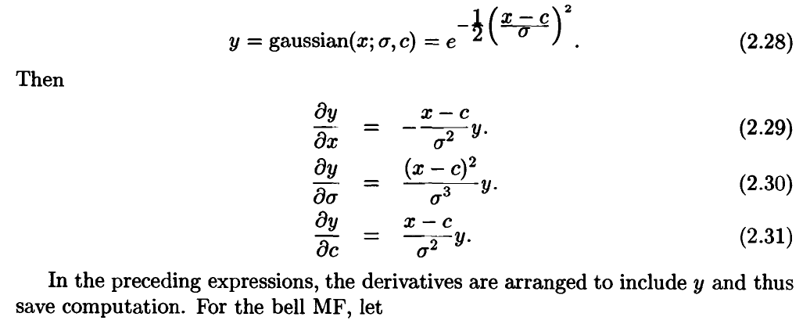
#Derivative of parameterized MFs
To make a fuzzy system adaptive, we need to know the derivatives of an MF with respect to its argument(inputs) and parameters. This derivative plays a central role in the learning or adaptation of a fuzzy system, that will be discussed in depth subsequent chapters. Here we list these derivatives for the Gaussian and bell MFs.

Slide 50
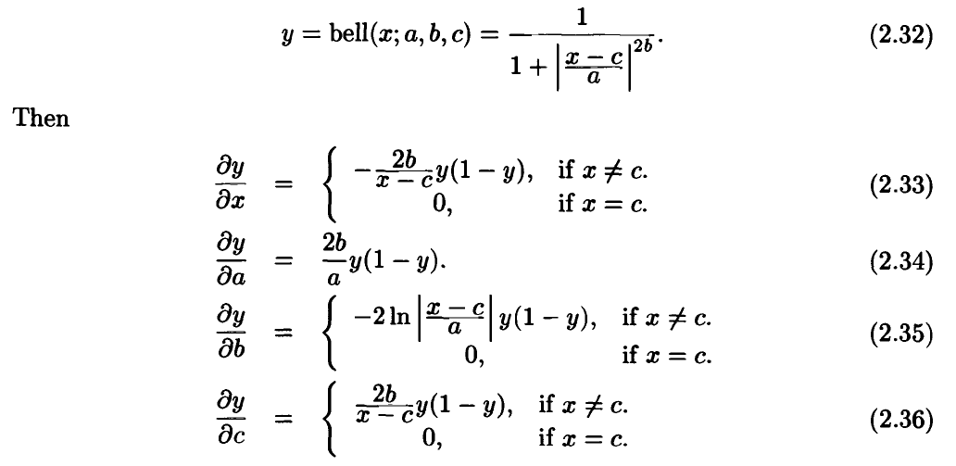

Slide 51
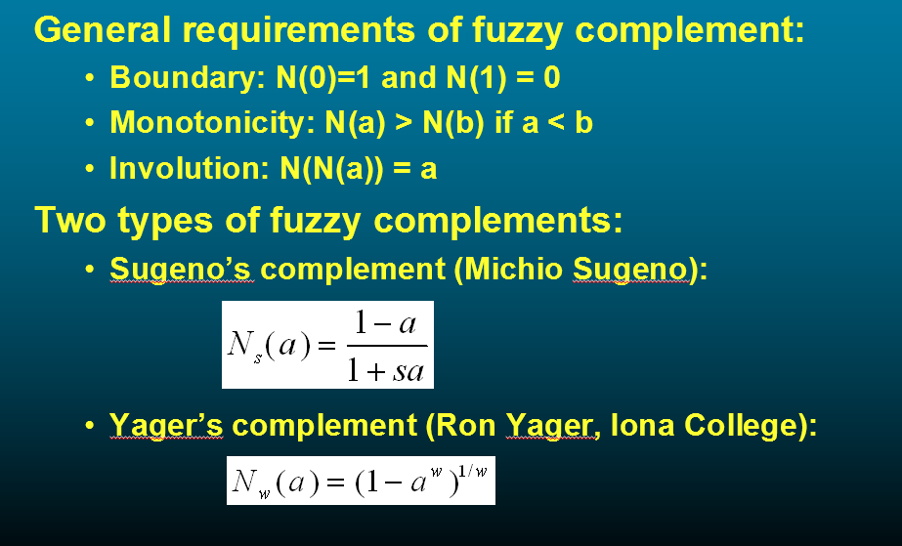
# More on fuzzy union, intersection and complement
A fuzzy complement operator is continuous function
N(a) : [0,1]→[0,1] which meet the general requirements:
Where, S > -1
Where, w is +ve parameter

Slide 52
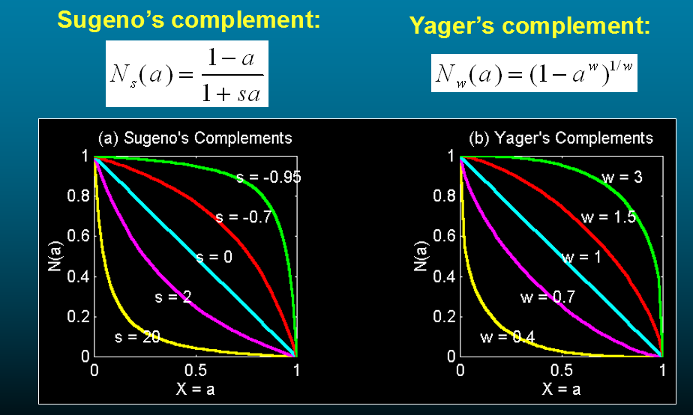
Fuzzy Complement

Slide 53


#Fuzzy Intersection and Union*

Slide 54



Slide 55


Slide 56



T-conorm or S-norm
Algebraic
sum:
Sa(a, b)
Bounded
sum:
Sb(a, b)
Drastic
sum:
Sd(a, b)
Maximum:
Sm(a, b)

Slide 57


Slide 58


Slide 59


Slide 60


#Generalized DeMorgan’s Law

